Slide 1
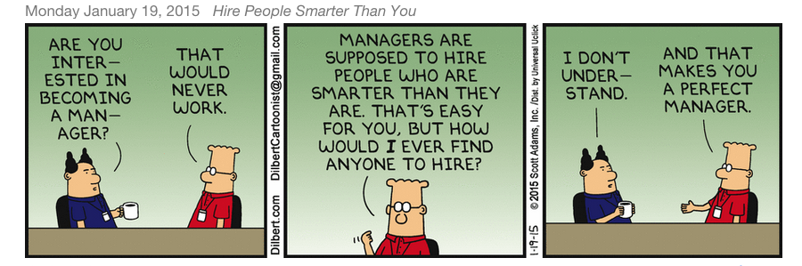
Management

Slide 2
Learning Objectives
Understand the definition of management
Understand the difference between effective and efficient
Understand the four main functions of management
Understand what a company is really selling
Understand the concept of competitive advantage
Know levels and types of managers
Know the important skills and rolls of a manager
Understand the history of management and how it affects the way we manage today

Slide 3
Management
Management involves the efficient use of resources to effectively achieve objectives through planning for the future, organizing the entity, leading and motivating constituents, and controlling activities.
Do you believe that effective management can be learned? Or is it something people are born with?

Slide 4
Effectiveness and Efficiency
A sales manager is given the goal of increasing sales by $1,000,000.
How can the manager reach this goal effectively?
How can the manager reach this goal efficiently?

Slide 5
Effective vs. Efficient
Effective
Efficient
Being effective has to do with how well the stated objectives or goals of the firm are met.
The sales manager may reach the goal by hiring more salespeople, increasing incentives, etc.
Being efficient has to do with the prudent use of resources—doing more with less.
To be efficient the sales manager would need to find ways to meet the goal with the resources she already has.
Hiring more individuals to help reach the goal may not be an example of efficiency.

Slide 6
YouTube Video
Effective vs. Efficient
Who is being effective, and who is being efficient?

Slide 7
Functions of Management
There are four main functions of management:
Planning
Organizing
Leading
Controlling

Slide 8
Functions of Management
Planning
Organizing
Leading
Controlling
Planning is the process of determining organizational direction to achieve a desired performance.
A goal is the desired future state; the plan is how to get there.
Plans and goals must be continually reviewed and revised.

Slide 9
Functions of Management
Planning
Organizing
Leading
Controlling
Organizing involves the deployment of resources, the assignment and grouping of tasks, and the delegation of responsibility.
Managers work with capital (money) and people, and must be deployed efficiently.
Jim Collins defined this as “getting the right people on the bus”, and then “getting them in the right seat on the bus.”

Slide 10
Functions of Management
Planning
Organizing
Leading
Controlling
Leading involves the use of power, persuasion, and influence to motivate and unite people in the attainment of organizational goals.
Leadership includes setting the example and pace for others to follow.

Slide 11
Functions of Management
Planning
Organizing
Leading
Controlling
Controlling is the process of monitoring the progress and correcting the deficiencies of the organization as it moves towards the fulfillment of its goals.
This includes checking employee performance, increasing efficiency, boosting performance.
Without proper controls, organizations can fall apart (entropy).

Slide 12
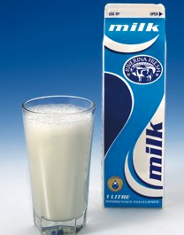
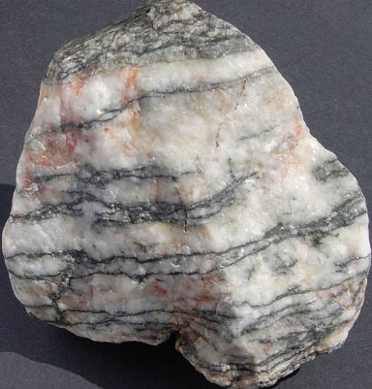
Creating VALUE
Discussion
Value = Benefits
Price

Slide 13
Competitive Advantage
A competitive advantage is what sets apart an organization from any other.
There are three main competitive strategies:
Differentiation
Cost leadership
Niche-focus

Slide 14
Differentiation
Toyota differentiates itself through quality and safety.
A differentiation strategy is one in which an organization sets its products or services apart by offering something new or different.
Usually focused on service or quality or functionality.

Slide 15
Cost Leadership
Wal-Mart offers its products at prices that competitors find it hard to match.
Cost leadership sets apart an organization by its ability to offer low prices.
This is usually achieved by companies with high volumes and highly efficient processes.

Slide 16
Niche/Focus
A restaurant focuses on one type of cuisine and caters its offerings to those who enjoy that type of food.
A niche/focus strategy focuses on a subset of a larger industry or a particular customer base of that industry.
Companies may become experts in one area of an industry rather than focus on the entire industry.

Slide 17
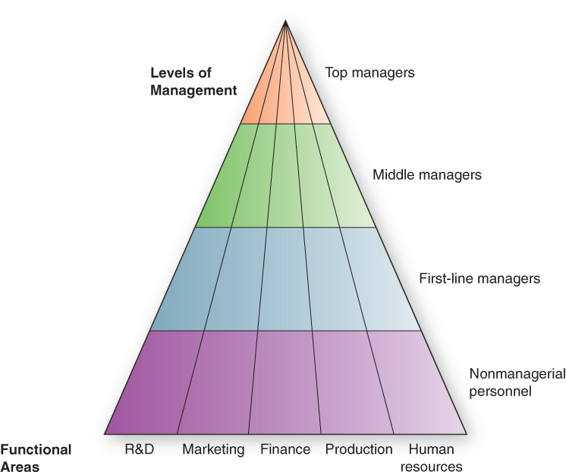
Pyramid Power: Levels & Areas of Management

Slide 18
Pyramid Power: Levels & Areas of Management
Top managers
make long-term decisions about the overall direction of the organization and establish the objectives, policies, and strategies for it

Slide 19
Pyramid Power: Levels & Areas of Management
Middle managers
implement the policies and plans of the top managers above them and supervise and coordinate the activities of the first-line managers below them
First-line managers
make short-term operating decisions, directing the daily tasks of nonmanagerial personnel
Notes:
Functional manager
responsible for just one organizational activity
General manager
responsible for several organizational activities

Slide 20
Pyramid Power: Levels & Areas of Management
Functional manager
responsible for just one organizational activity
General manager
responsible for several organizational activities

Slide 21
The Skills Star Managers Need
Technical skills
the job-specific knowledge needed to perform well in a specialized field – Front Line Managers
Conceptual skills
the ability to think analytically, to visualize an organization as a whole and understand how the parts work together – Top Manager

Slide 22
The Skills Star Managers Need
Human skills
the ability to work well in cooperation with other people to get things done – All Levels
Organizational skills
the ability to manage one’s time, processing inflows and outflows of information and responsibilities – the ability to get things done

Slide 23
Complexities of Management
Fragmentation (3 minutes per task)
Span of management (expanding)
Outsourcing (best resources vs. loyalty)
Organizational Skills/Scheduling our attention
Virtual or Online networks
Technology driving force of change.
Necessity to understand cultures

Slide 24
Management and Organization
0
Managers must “see the big picture” including forces external to the organization:
Social Forces: culture and values.
Political Forces: political and legal institutions and systems and changes to them.
Economic Forces: interest rates, unemployment rates, infrastructure, etc.
Mangers must face environmental turbulence

Slide 25
Question?
Donielle supervises the food assembly line workers. What type of manager is she?
Top manager
Middle manager
First-line manager
General manager
Notes:
The correct answer is “C” – first-line manager. See slide 1-24.

Slide 26
Roles Managers Must Play Successfully
The manager’s roles: Mintzberg’s useful findings
A manager relies more on verbal than on written communication
A manager works long hours at an intense pace
A manager’s work is characterized by fragmentation, brevity, & variety

Slide 27
Three Types of Managerial Roles
Interpersonal roles
managers interact with people inside and outside their work units
figurehead, leader, liaison
Informational roles
managers receive and communicate information
monitor, disseminator, spokesperson

Slide 28
Three Types of Managerial Roles
Decisional roles
managers use information to make decisions to solve problems or take advantage of opportunities
entrepreneur, disturbance handler, resource allocator, negotiator

Slide 29
Are You a New-Style or an Old-Style Manager?
0
Management and managers are undergoing tremendous change
Past strategies are no longer effective in today’s dynamic business environment
History provides perspective and a broader view
Manager can find patterns and insight from history

Slide 30
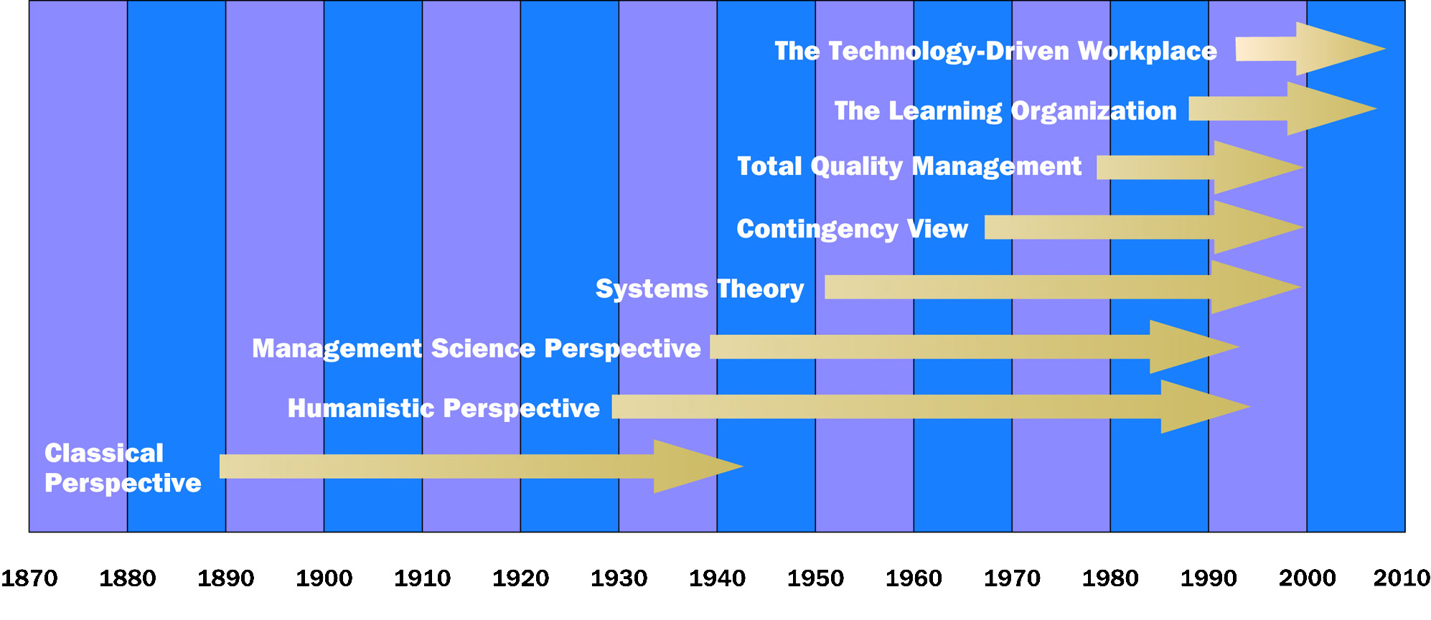
Management Perspectives Over Time
0

Slide 31
Classical Perspective
0
The early study of management.
19th – late 20th Century
Scientific Management
Bureaucratic Organizations
Administrative Principles
Very powerful, gave companies fundamental skills for high productivity
Helped US surge in management techniques and become the world leader in productivity

Slide 32
Classical Management Perspective
Scientific Management
Administrative Management
Includes analyzing proper methods and selecting, training, and incentivizing employees.
Frederick Winslow Taylor studied various tasks and then selected workers with the proper skills for those tasks.
Monetary incentives were given to workers to meet production quotas.
Max Weber and Henri Fayol were early proponents of administrative management.
Main principles include:
Clear hierarchy
Hiring/promotions based on merit
Clear division of labor

Slide 33
YouTube Video
Ford and Taylor Scientific Management (Edited)

Slide 34
Scientific Management
0
Frederick Winslow Taylor (1856-1915), father of scientific management
Focus on improving efficiency and labor productivity
Workers could be retooled like machines
Managers would need to change
Incentive systems for meeting standards
Others added to the theories
Lillian M. Gilbreth added a human component to the study

Slide 35
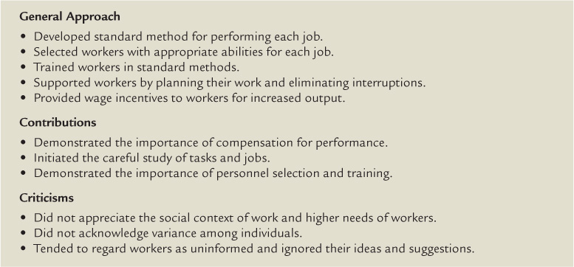
Characteristics of Scientific Management
0

Slide 36
Bureaucratic Organizations
0
Max Weber (1864-1920), a German theorist introduced the bureaucratic theories
Rational authority—more efficient and adaptable to change
Selection and advancement would be focused on competence and technical qualifications not solely on relationships
The term bureaucracy has taken on a negative tone, associated with endless “red tape”

Slide 37
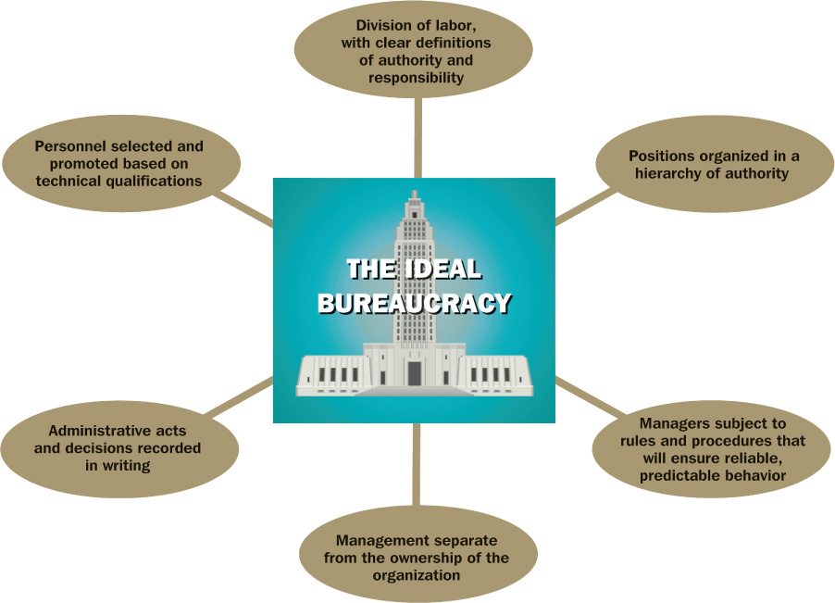
Characteristics of Weber’s Bureaucracy
0

Slide 38
Administrative Principles
0
Henri Foyal (1841-1925), French mining engineer and other contributors led the ideas
Foyal wrote down his own management practices
In the text, General and Industrial Management; 14 general principles were outlined
Several of the principles include:
Unity of Command
Division of Work
Unity of Direction
Scalar Chain
Foyal identified five functions of management: Planning, Organizing, Commanding, Coordinating, and Controlling
Notes:
We’ve softened Foyal’s Commanding to Leading and collapsed Coordinating and Controlling to just controlling; POLC

Slide 39
Humanistic Perspective
0
Led by Mary Parker Follett and Chester Barnard
Importance of understanding human behaviors: needs, attitudes and social interactions
Human Relations Movement
Human Resources Perspective
Behavioral Sciences

Slide 40
Human Relations Movement
0
Control comes from the individual worker rather than authoritarian control
The Hawthorne studies found increased output due to managers’ better treatment of employees
Money mattered a great deal
Productivity increased from feelings of importance
Created a focus on positive treatment of employees

Slide 41
Human Resources Perspective
0
Focus on job tasks and theories of motivation
Reduce dehumanizing or demeaning work
Allow workers to use full potential
Main contributors: Abraham Maslow and Douglas McGregor
Maslow’s Hierarchy of Needs
McGregor’s Theory X/Theory Y
Perspective came from the idea that cows gave more milk when they were more satisfied

Slide 42
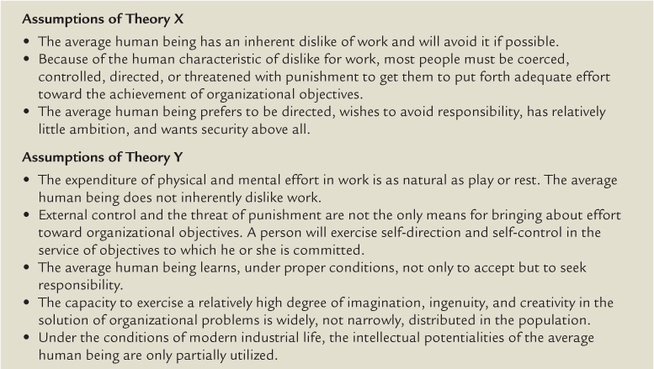
Theory X and Theory Y
0

Slide 43
Behavioral Sciences Approach
0
Scientific methods that draw from sociology, psychology, anthropology, economics and other disciplines
Focus on human behavior and interaction
Organizational development came from behavioral sciences approach
Applied behavioral sciences to improve organizational health and effectiveness

Slide 44
Management Science Perspective
0
Developed to meet changing and dynamic environment created from WWII
Engaged mathematics, statistics and quantitative techniques to aid in decision making
Increased study of management led by Peter Drucker
Use of technology and programming for optimizing operations
Introduced new subsets of management:
Operations Research
Operations Management
Information Technology

Slide 45
Recent Historical Trends
0
Systems Theory. A holistic view of management as a interrelated parts to achieve a common purpose.
Contingency View. Successful resolution of organizational problems depends on situations.
Total Quality Management. Management of the total organization to deliver quality.
TPS. Toyota Production System.

Slide 46
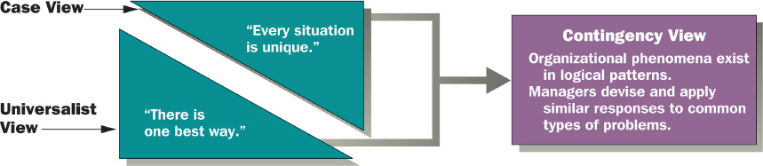
Contingency View of Management
0

Slide 47
Total Quality Management
0
W. Edwards Deming, known as the father of the quality movement
US initially scoffed at Deming
During the 1980s and 1990s, quality became a focus to meet global competition
Four key elements of quality management:
Focus on customer
Employee involvement
Benchmarking
Continuous improvement

Slide 48
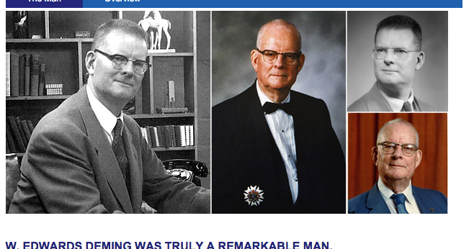
W. Edwards Deming

